Slide 1
How Well is the Federal Government Collecting
and Spending Your Money?
Kevin Page
CAMIC
Canadian Association of Mutual Assurance Companies of Canada
Ottawa, ON
Tuesday, February 6, 2018
© Copyright 2016 IFSD Institute of Fiscal Studies and Democracy. All Rights Reserved.

Slide 2
Key Messages
Hard to argue against economic success
Success in spite of relatively weak budget institutions and processes
Risks are building

Slide 3
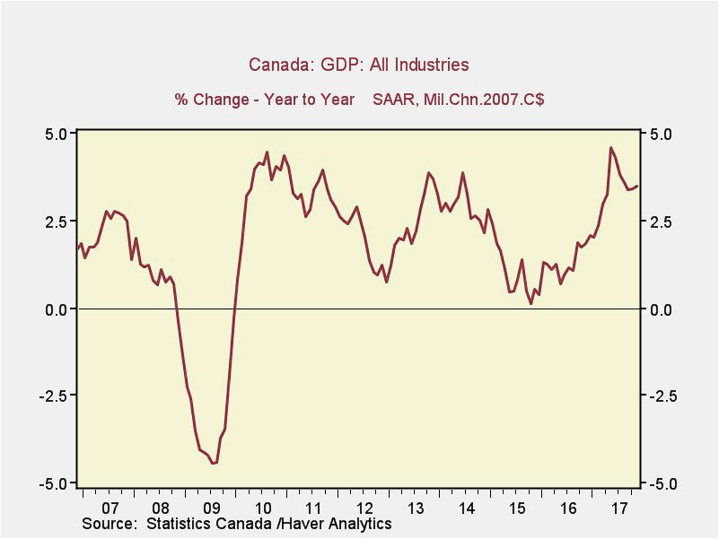
Economy

Slide 4
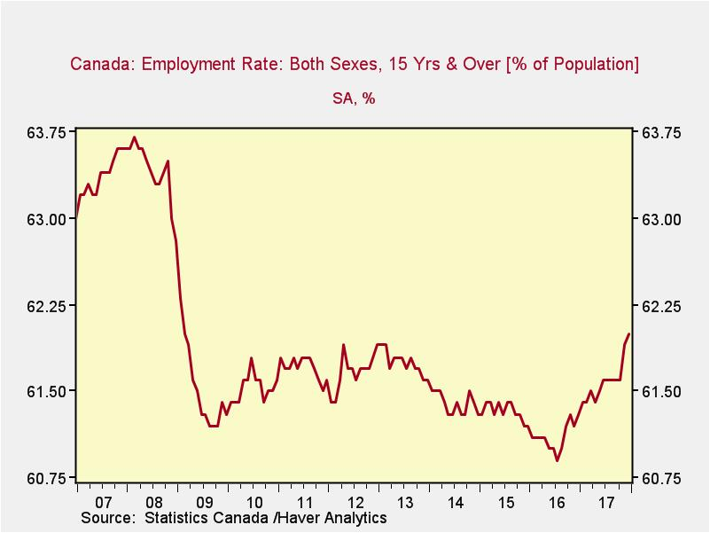
Economy

Slide 5
Budget Big Ticket Items
Middle Class Tax Cut
Canada Child Benefit
EI
Infrastructure (Phase 1)
Indigenous Peoples
Environment
Veterans
Skills and Innovation
Infrastructure (Phase 2)

Slide 6
Government Agenda
Mandate Tracker
364 Commitments
68
Completed
Fully Met
1
Completed
Modified
216
Underway on
Track
13
Underway with
Challenges
3
Not being
Pursued
21
On-going
Commitment
Commitments Tracked Across 12 Priorities
Government Addressing Long term Issues

Slide 7
Spending is Up
$22.2 billion
PM Harper Budget 2015

Slide 8
Government Polling
Probability of Winning Election Held Today (%)
CBC Eric Grenier
Liberal Minority 18%
Liberal Majority 77%

Slide 9
Fiscal Metrics
Revenues
LT Average 16.4
2016/17 Value 14.5
Program Expenses
LT Average 14.3
2016/17 Value 14.2

Slide 10
Fiscal Metrics
Budgetary Balance
LT Average -2.4
2016/17 Value -0.9

Slide 11
Budget Institutions & Processes
How does budget transparency in Canada compare to other countries?
Country | Score
Sweden | 87
Norway | 85
United States | 77
France | 74
United Kingdom | 74
Italy | 73
Canada | 71
Germany | 69
Portugal | 66
Spain | 54
Open Budget Survey 2017: International Budget Partnership

Slide 12
Budget Institutions & Processes
To what extent does the legislature in Canada provide budget oversight?
29/100
Formulation / Approval
Weak Oversight
80/100
Execution / Audit
Adequate Oversight
Open Budget Survey 2017: International Budget Partnership

Slide 13
Budget Institutions & Processes
To what extent do different institutions in Canada provide opportunities for public participation?
Country | Score
United Kingdom | 57
Canada | 39
United States | 22
France | 17
Germany | 17
Norway | 17
Sweden | 17
Portugal | 15
Italy | 7
Spain | 2
Executive 27/100 ---few opportunities
Legislature 75/100 adequate opportunities
Audit Institution 33/100 ---few opportunities
Open Budget Survey 2017: International Budget Partnership

Slide 14
Risks – Debt
Spending
Accumulated Deficit
$732b
 | 2017-18 | 2022-23 | %Change
Programs | $304.9b | $347.9b | 14.1
Interest | $24.2b | $32.8b | 35.5
$632b
$458b
2008
2017
2023 est
Up $174b
Up $100b

Slide 15
Risk – Spending Control

Slide 16
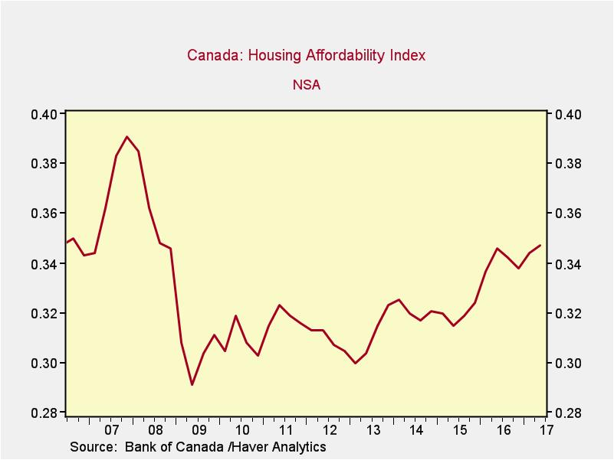
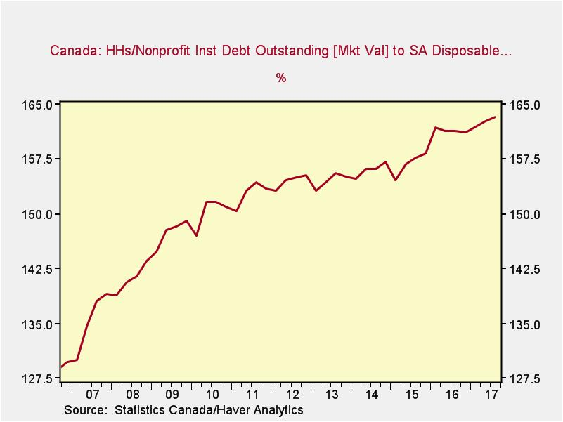
Risk – Economy
Vulnerability to an economic shock increases with high levels of household debt

Slide 17
Follow us on Twitter!
@IFSD_IFPD

